Slide 1
Project-8
Job Market Analysis & Recommendation System
NextHikes Solutions
By - Rakshit A Solanki

Slide 2
Project Overview
The job market changes continuously due to Technology, Business needs & Economic conditions.
Job posting data helps identify salary patterns emerging categories and high demand roles.
This project analyzes job posting to discover useful trends and support job seekers.
A recommendation system dashboard were developed to make job information easier to explore.
A flask-based web application was developed to provide job search, keyword-based recommendation & job demand forecasting features.

Slide 3
Problem Statement
Job seekers often find it difficult to identify suitable opportunities and understand salary trends.
Job titles, formats and posting frequencies vary across job listings.
Changes in posting volume can make it difficult to identify genuine growth in demand.
The project aims to analyze these patterns, forecast job demand and provide keyword-based recommendations.

Slide 4
Dataset Information
Dataset structure
  The dataset contains 2,44,828 job postings with 8 columns.
  Each row represents a job posting collected from the job market dataset.
  The data covers the period from November 2023 to March 2024.
Important variables
  Title : Job title or Role.
  Published date : Date when the job was posted.
  Is hourly : indicates weather the job is hourly-based.
  Budget : Project based budget information.
  Country : Country associated with the job.
  Link : URL of the job posting.

Slide 5
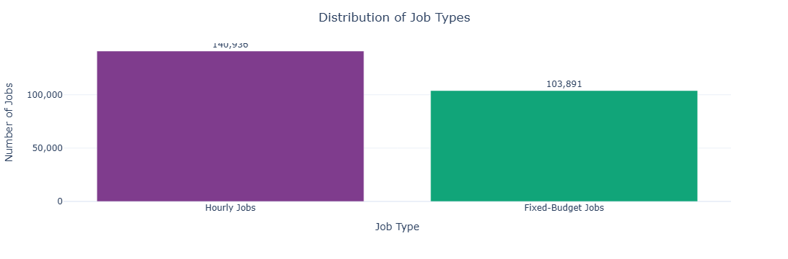
Univariate Analysis
The dataset contains 2,44,827 job postings after preprocessing.
Hourly jobs account for 1,40,936 postings (57.57%).
Fixed budget jobs account for 1,03,891 postings (42.43%).
Hourly jobs represents the larger share of job postings in the dataset.

Slide 6
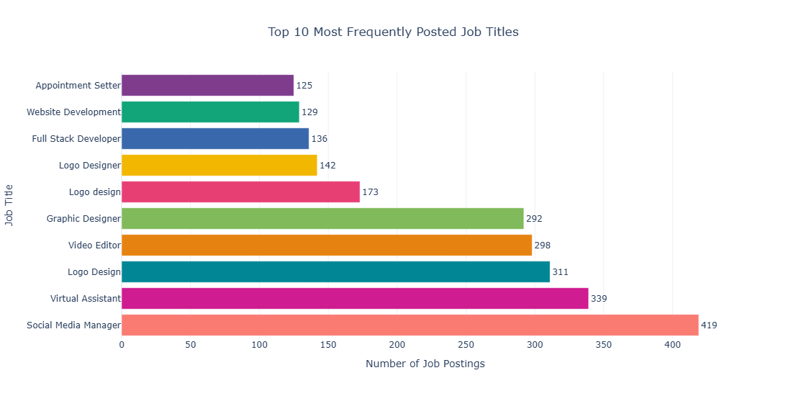
Univariate Analysis
Social media manager is the most frequently posted title among top 10 with 419 postings.
Virtual assistant rank second with 339 postings.
Video editor has 298 postings while Graphic Designer has 292 postings.
These counts highlight frequently appearing job titles in the dataset.

Slide 7
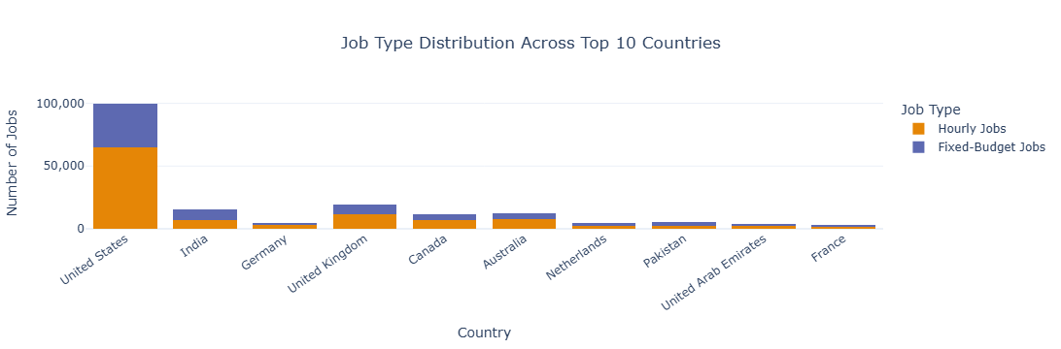
Bivariate Analysis
The United States has 99,834 postings, including 64,794 hourly jobs and 35,040 fixed budget jobs.
The United Kingdom has 11,335 hourly jobs and 7,814 fixed budget jobs.
India has more fixed budget jobs 9,046 than hourly jobs 6,789.
The job type mix differs across countries.

Slide 8
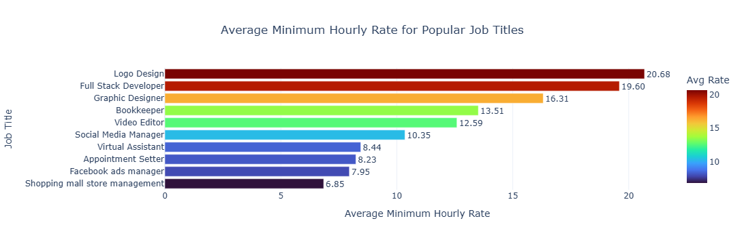
Multivariate Analysis
Logo design has the highest average minimum hourly rate among the ten displayed titles at 20.68 across 81 records.
Full stack developer ranks second at 19.60 across 84 records.
Graphic Designer has an average minimum rate of 16.31 across 164 records.

Slide 9
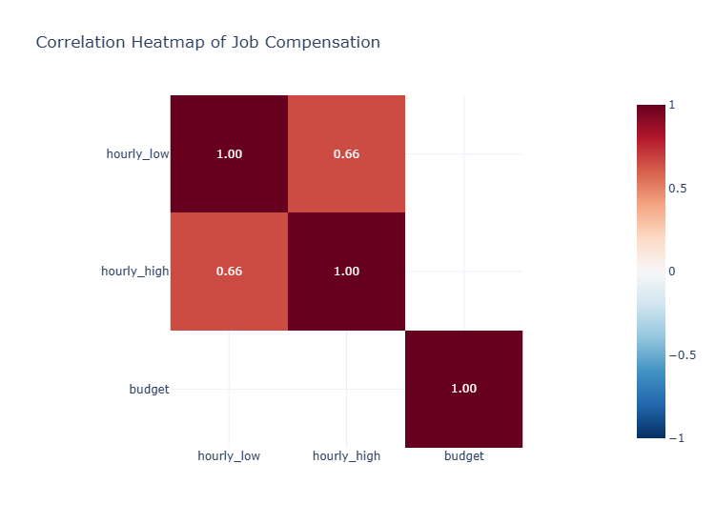
Correlation Heatmap
The heatmap examines relationships between hourly minimum rates, maximum rates & project budgets.
Correlation values help identify the direction and strength of linear relationship.
Compensation fields have substantial missing data so the analysis uses available values.

Slide 10
Feature Engineering
Date based features were extracted from the job posting date to analyze job market trends over time.
The year and month were extracted to track changes in job posting frequency.
The month name was created to make monthly trend analysis easier to understand.
The day & weekday were extracted to study job posting patterns by date.
These features supported monthly trend visualization and time based job demand forecasting.

Slide 11
Outlier Detection
The interquartile range (IQR) method was used to identify potential outliers in the compensation related numeric columns.
The budget column contained the highest number of outliers with 12,993 records.
The hourly minimum rate column had 8,450 outliers.
The hourly maximum rate column had 7,029 outliers.
Budget values showed more extreme variation compared to the hourly rate columns.
This outliers may represent usually high or low job compensation values.s

Slide 12
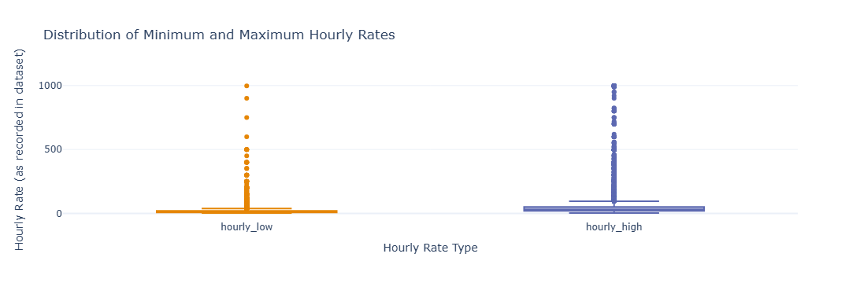
Compensation Distribution
The median minimum hourly rate is 15.00 while the median maximum rate is 30.00
The middle 50% of minimum hourly rates ranges from 8.00 to 20.00.
The middle 50% of maximum hourly rates ranges from 20.00 to 50.00.

Slide 13
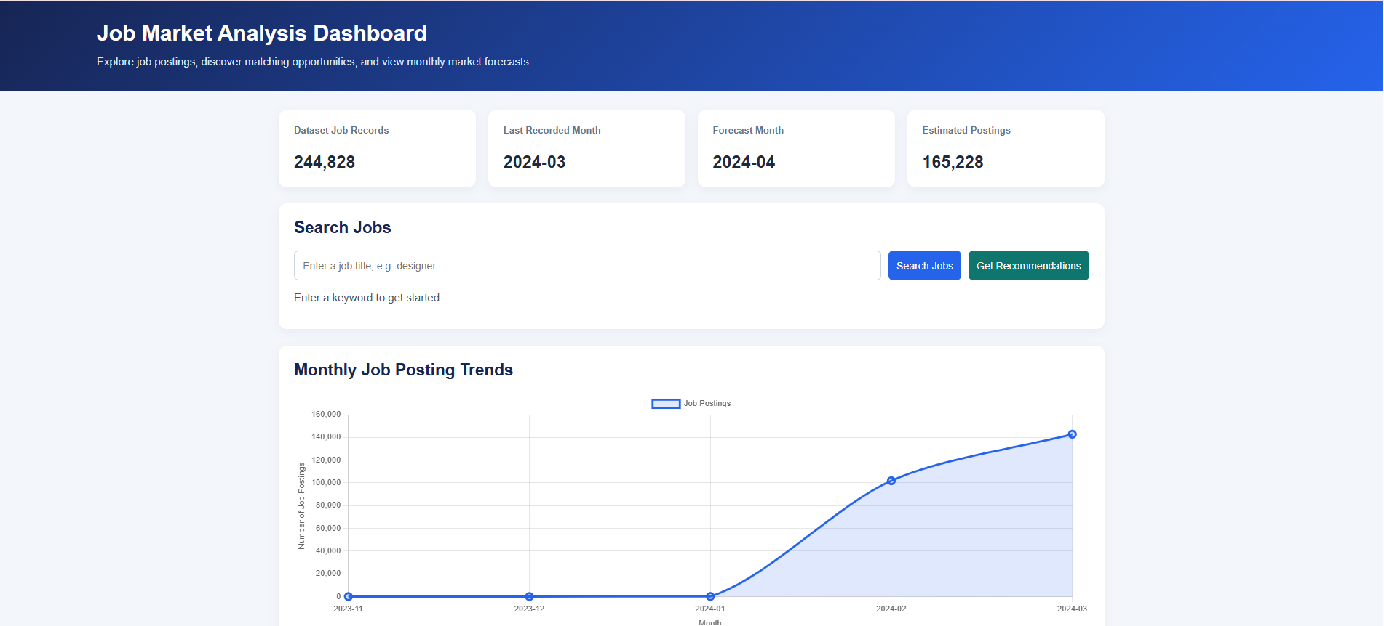
Web Application & Deployment
A web application was developed using Flask to make the job market analysis system accessible through a user-friendly interface.
A keyword-based job search feature was implemented to find relevant job postings.
A recommendation feature was developed to suggest relevant job based on the entered keyword.

Slide 14
Business Insights
The United States had the highest number of job posting followed by the United Kingdom and India.
Hourly jobs accounted for 57.57% of postings while fixed-budget jobs accounted for 42.43%.
Social media manager, virtual assistant, video editor & graphic designer were among the frequently posted job titles.
The median maximum hourly rate was 30 compared with 15 for the minimum hourly rate.
Job posting counts increased from 1,01,886 in February 2024 to 1,42,834 in March 2024.

Slide 15
Conclusion
The project analyzed job market data to identify hiring patterns, popular job titles & country wise job opportunities.
Data cleaning & feature engineering prepared the dataset for further analysis.
Univariate, Bivariate & Multivariate visualizations helped reveal important job market trends.
A keyword-based recommendation system was developed to help users find relevant job postings.
A forecasting model was implemented to estimate future job posting demand.

Slide 16
Reference Links Used For Learn
https://www.geeksforgeeks.org/data-analysis/data-analysis-with-python/
https://www.geeksforgeeks.org/data-analysis/exploratory-data-analysis-in-python/
https://www.geeksforgeeks.org/data-visualization/python-data-visualization-tutorial/
https://www.geeksforgeeks.org/machine-learning/ml-linear-regression/
https://www.geeksforgeeks.org/python/flask-tutorial/
https://scikit-learn.org/stable/modules/generated/sklearn.linear_model.LinearRegression.html

Slide 17
Thank You

